Slide 1

A “HAPPENING” in Jungle Terrace!~!
Artists Call for “Paint-A-Post” under Tyrone Overpass became
“Pillars of Passion Garden” in Stonehenge Park on Pinellas Trail

Slide 2
Beautify Our City – “Paint-A-Post”
Tyrone Underpass/Stonehenge Park on Pinellas Trail by Tyrone Mall/Cobb 10 Movies
A Community Service Project by Jungle Terrace Civic Association Nonprofit 501(c)3
Posts are 3 feet wide. Paint 1 - 4 sides to 8 feet high.
Jungle Terrace cleans, primes posts, and pays cost of materials.
Volunteers preferred (small stipend possible).
Artists are featured in JTCA Newsletter and to City/County/Art Organizations.
Send proposals to: Linn Sennott LSennott@tampabay.rr.com

Slide 3
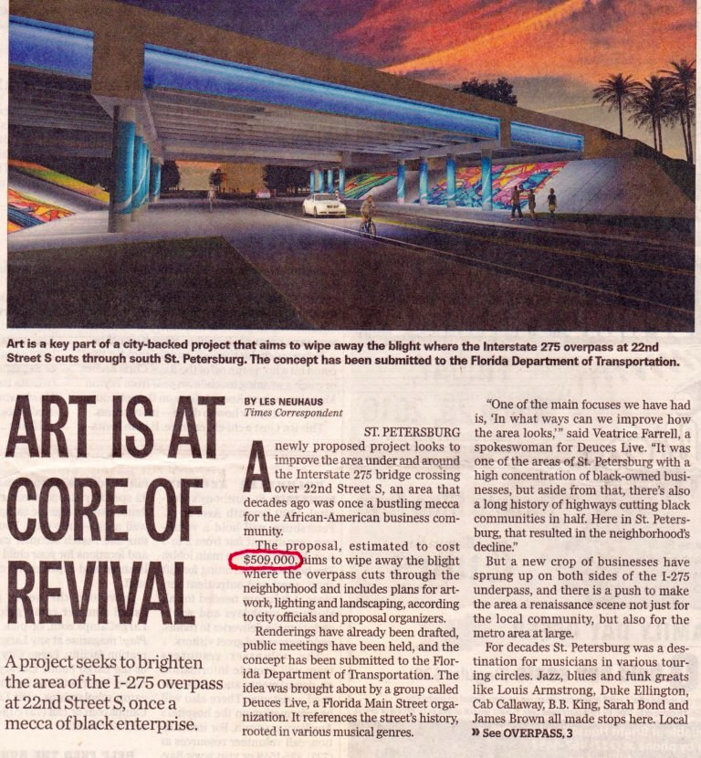

Slide 4
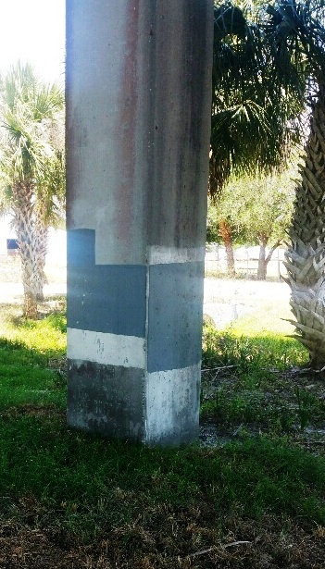
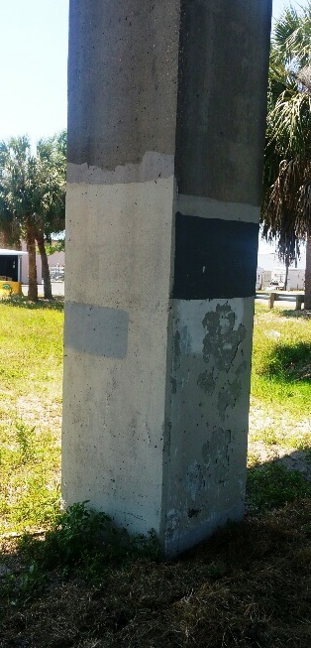
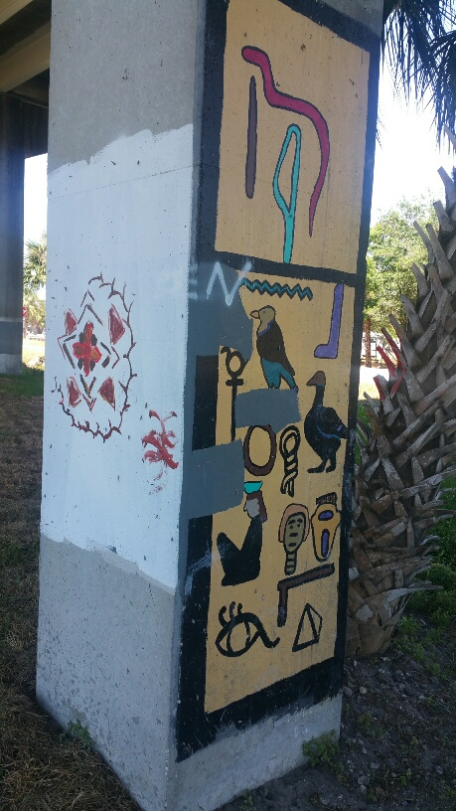
BEFORE

Slide 5
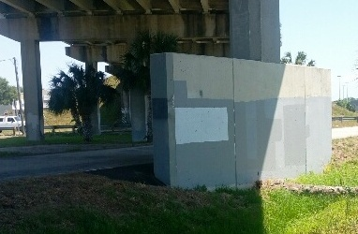
BEFORE

Slide 6
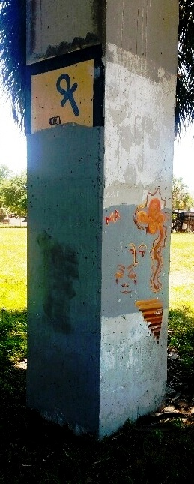
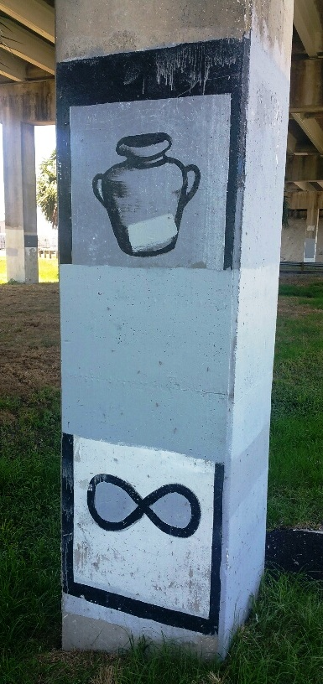
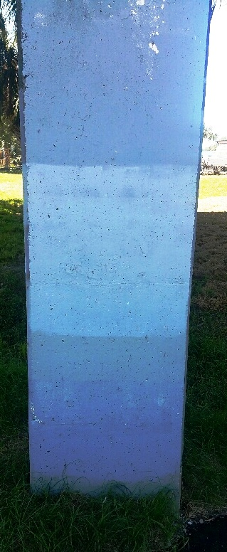
BEFORE

Slide 7
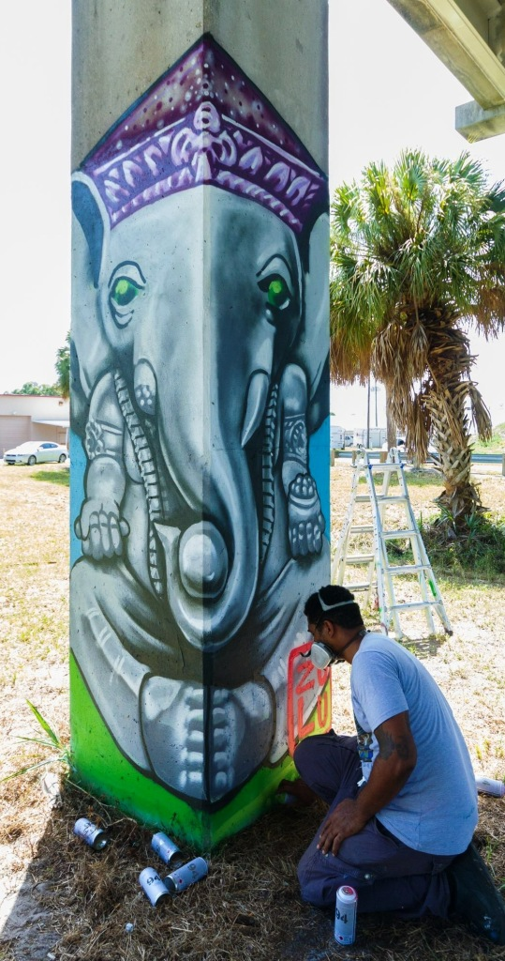
Beautified and Improved
“Pillars of Passion Garden”
“Zulu Painter” Carlos Culbertson

Slide 8
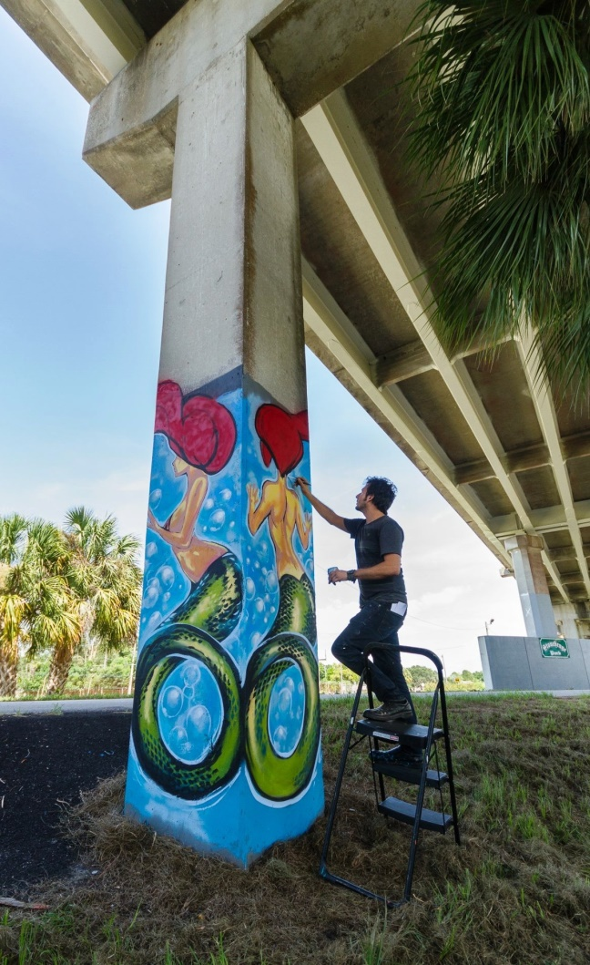
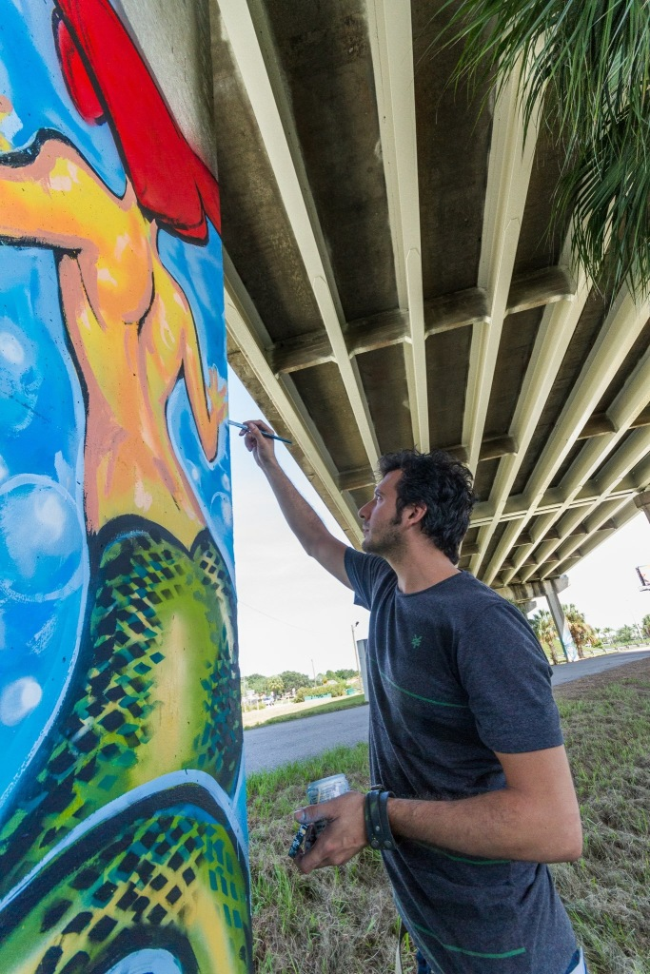
John Suarez - Celebrating Rep. Kathleen Peters

Slide 9
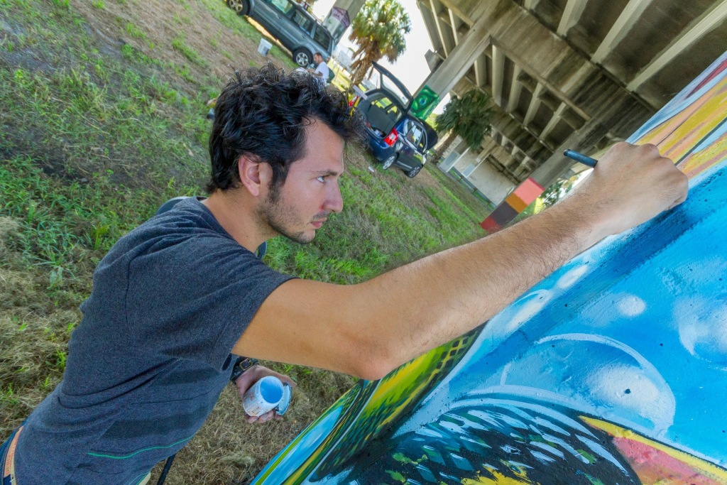
Final Touches by John

Slide 10
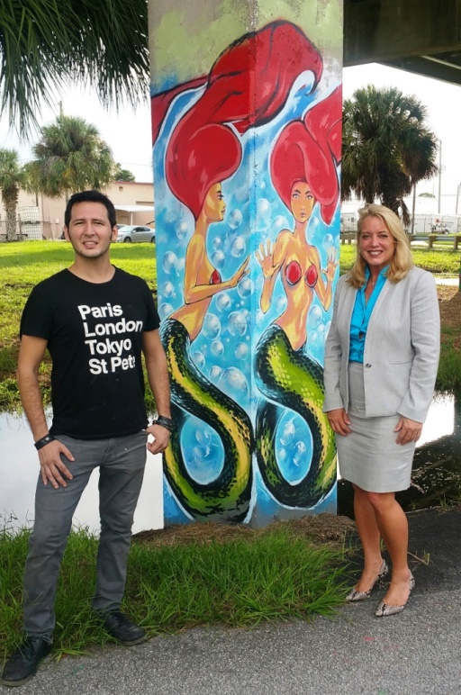
FL Rep. Kathleen Peters & Artist John Suarez
Dedicated Pillar of Strength and Passion

Slide 11
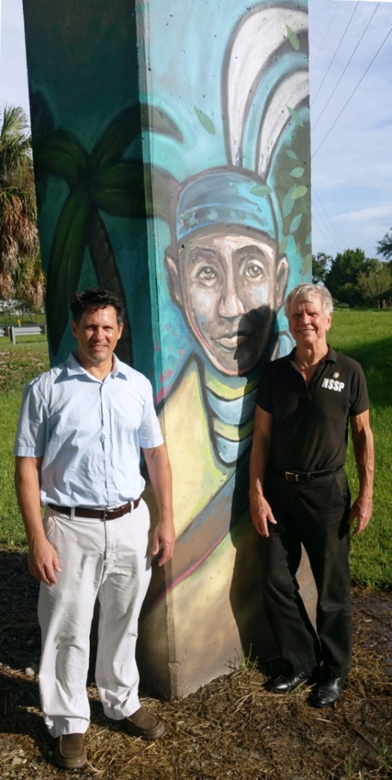
Pillar Celebrating Lyle Fowler
County Parks Director (So.)

Slide 12
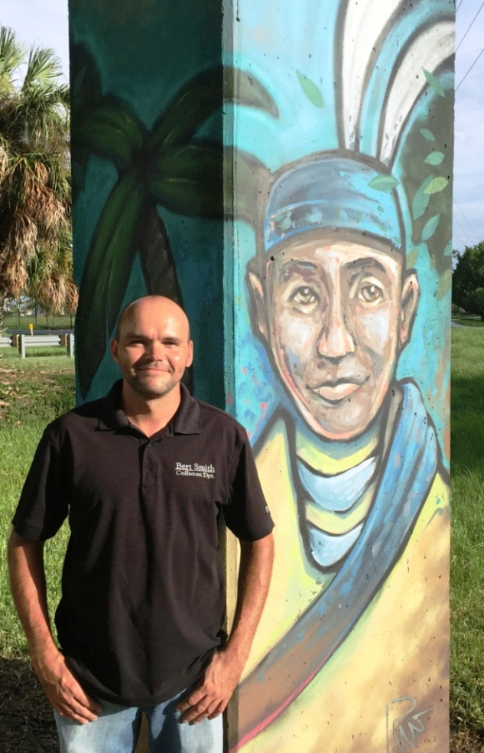
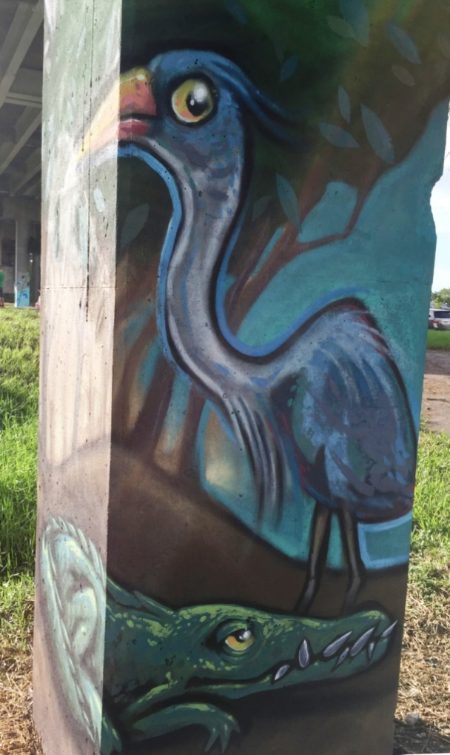
Russell Wheeler

Slide 13
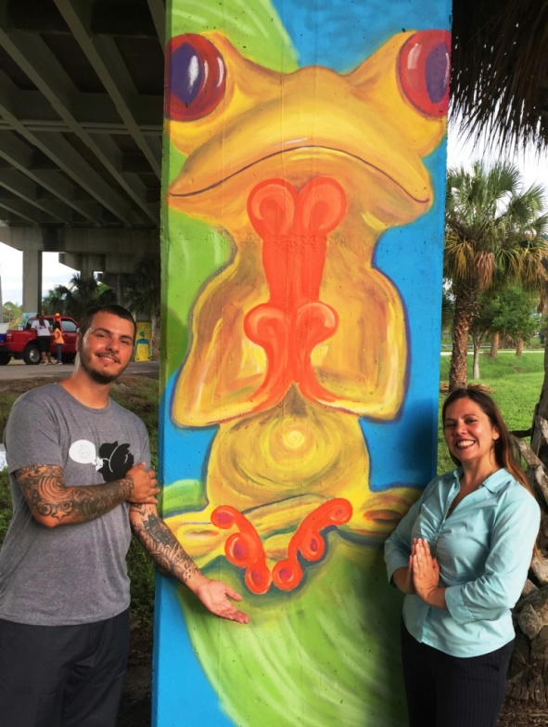
Freddie Fred and Kim

Slide 14
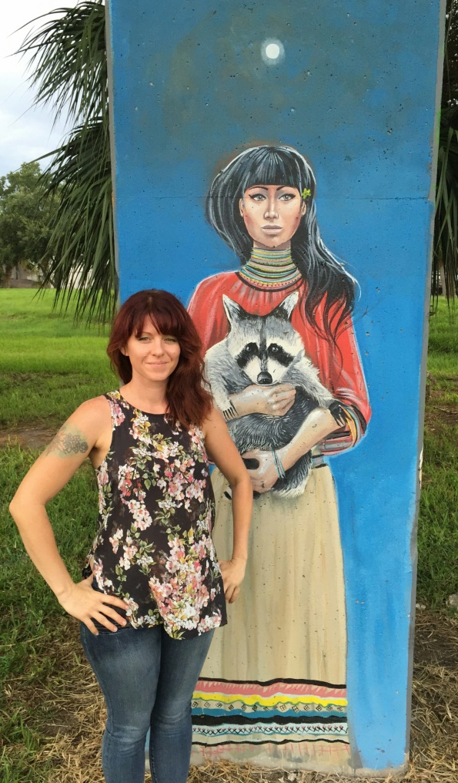
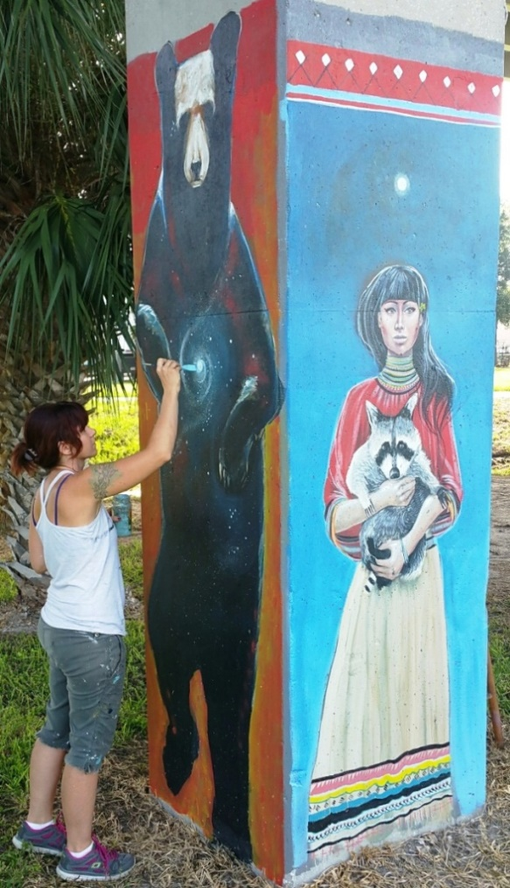
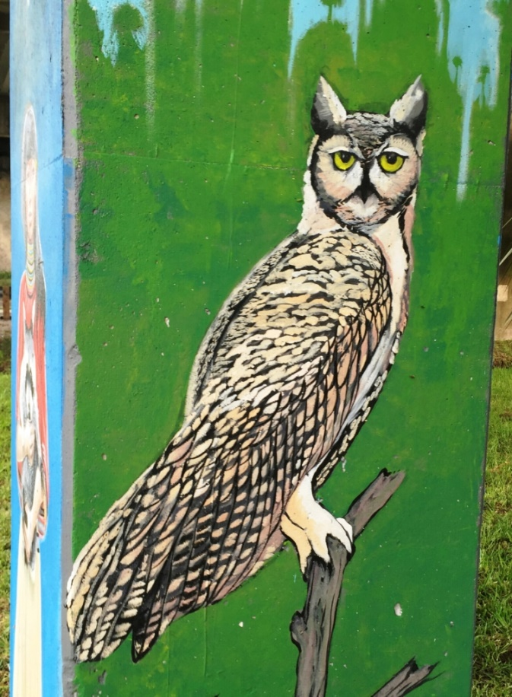
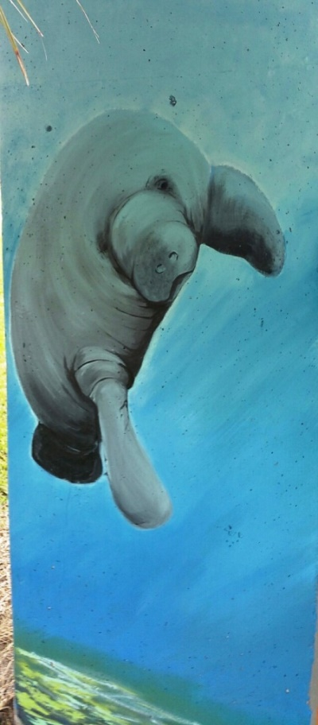
Jenipher Chandley + 4 Sides of Pillar

Slide 15
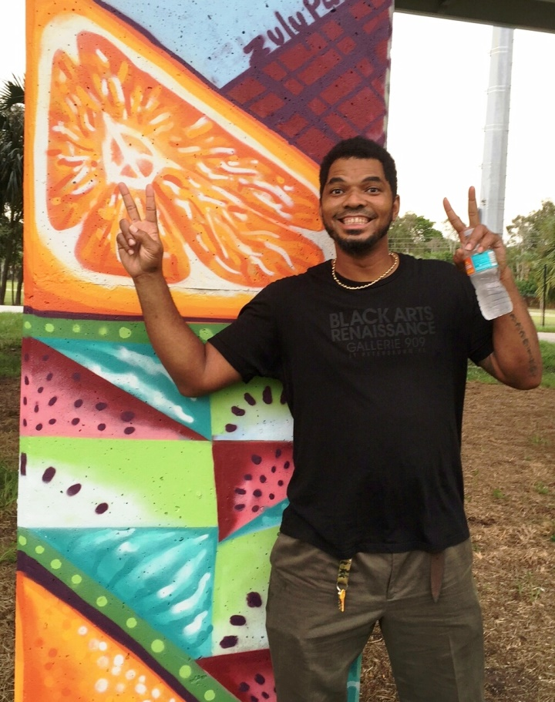
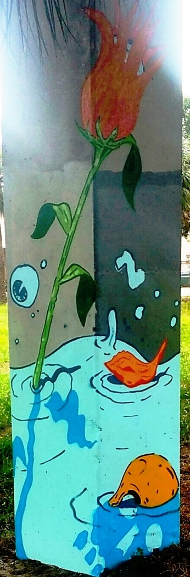
“Zulu Painter” Carlos Culbertson
Sebastian Coolidge

Slide 16
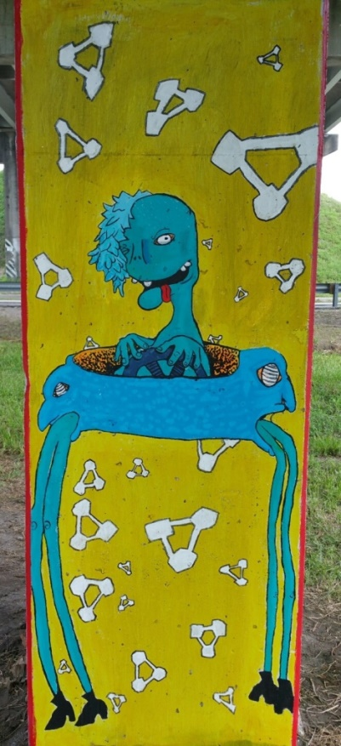
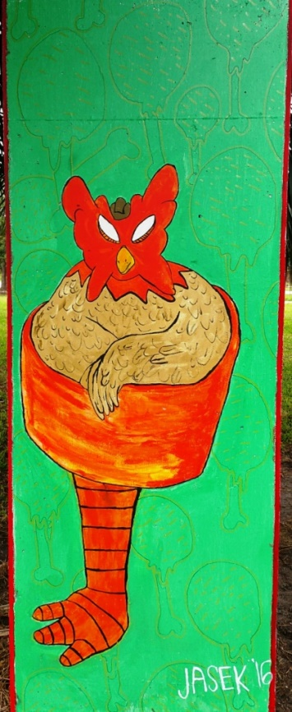
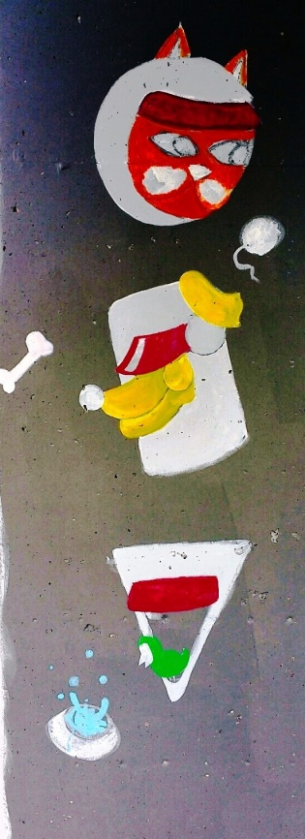
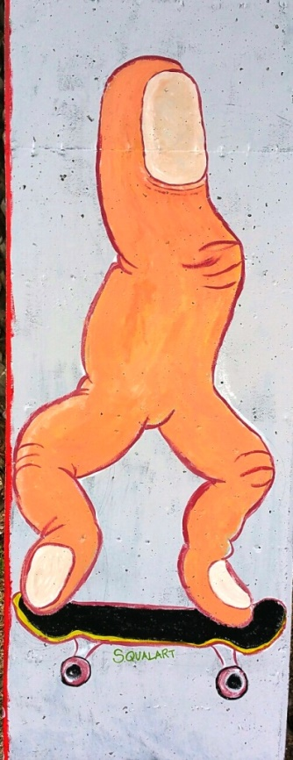
Eric Jasek

Slide 17
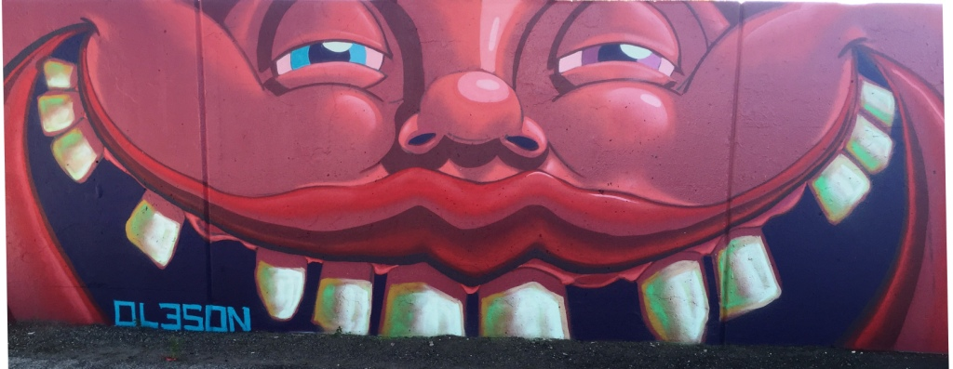
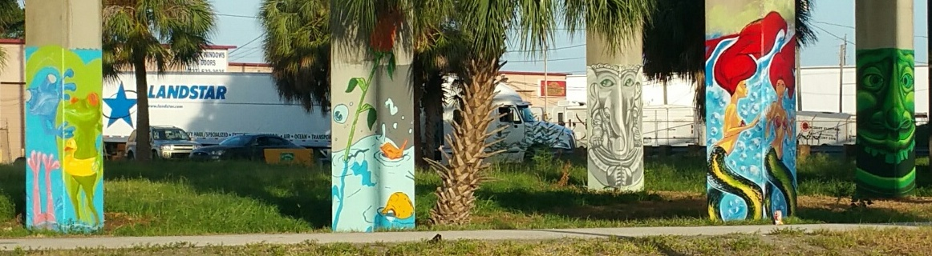

Slide 18
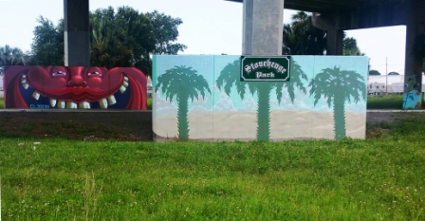
James Oleson and Zulu Painter

Slide 19
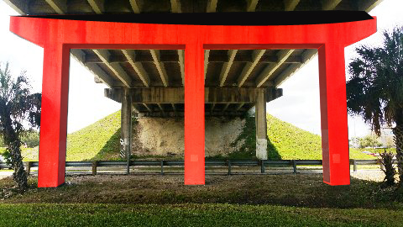
Concept for 3 Pillars + Lintel

Slide 20
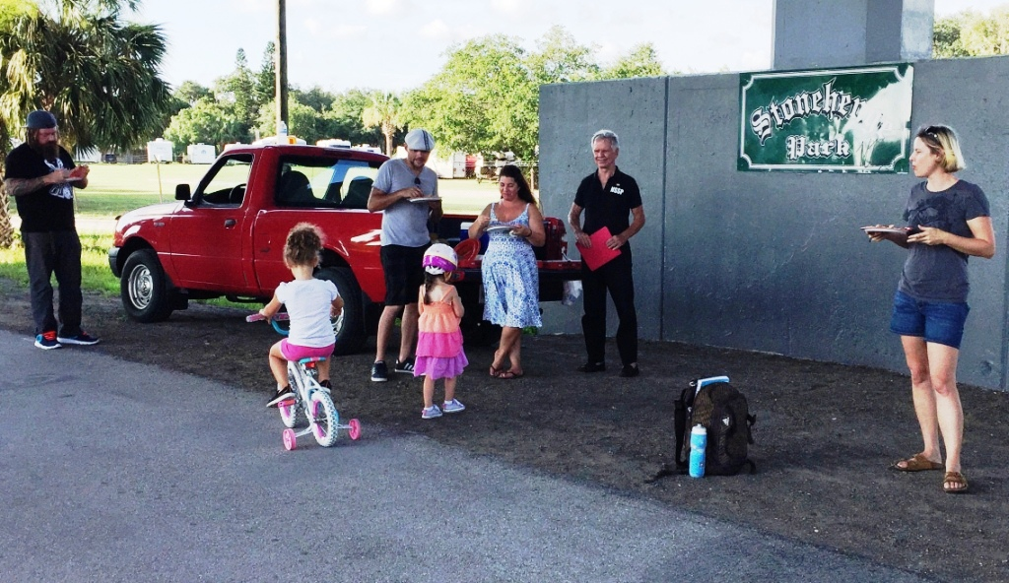
“Paint-A-Pillar” Pizza Party

Slide 21
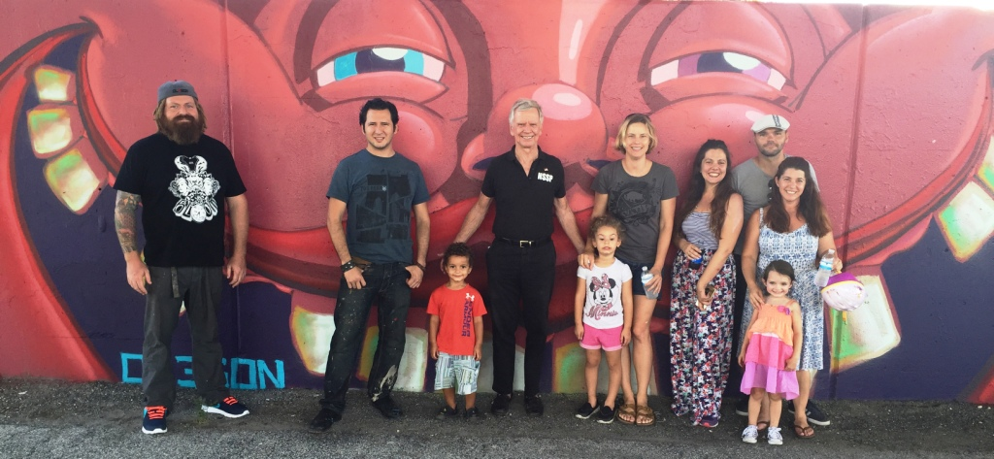
THANK YOU ARTISTS FOR ALL YOUR WORK!

Slide 22
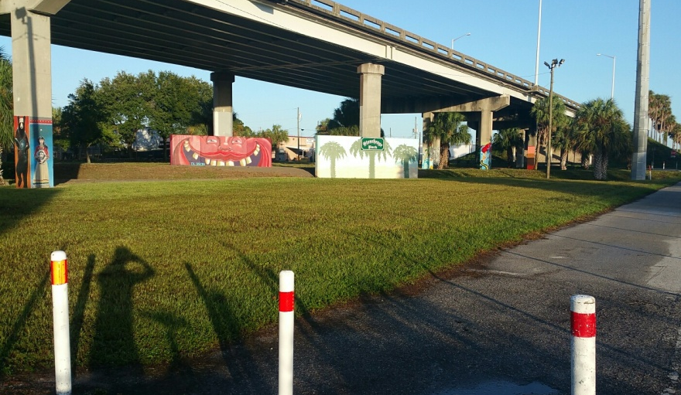
FDOT cooperates with super good mowing, weed-eating and litter removal!

Slide 23
Your Neighborhood
Mini-Grant $500 Neighborhood Grant $20,000 Public Art
Artists ~ James Oleson
OlesonArt@gmail.com
352-777-3723
Jungle Terrace process Info
Linn Sennott
LSennott@tampabay.rr.com
727-599-5819

